Slide 1

DevOps & Cloud Infrastructure SEIS 665 Week 1
Jason Baker
Adjunct Instructor
Graduate Programs in Software
University of St. Thomas
St. Paul, MN

Slide 2

Agenda
Introduction to the course
Review syllabus
Source control management & Git

Slide 3
About Your Instructor
2015 Graduate of UST GPS program with M.S. in Software Engineering
20+ years in IT working with startups and Fortune 500
Technical co-founder of a large regional datacenter and managed services provider
AWS Certified Solutions Architect & Developer
Hobbies include underwater photography, cycling, and electronics.

Slide 4

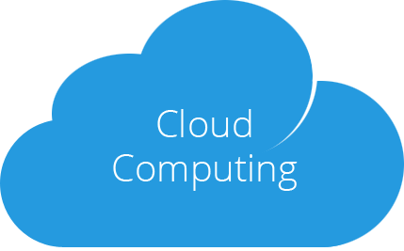
Class Topics this semester
Deploy and manage infrastructure using some of the same techniques developers use to build software.
Infrastructure and applications made available via the Internet as a utility service.

Slide 5
Infrastructure
What do we mean by “infrastructure”?
IT infrastructure provides all the necessary hardware and software components necessary to deliver a service.
Almost every software application consumes some amount computation power, data storage, and network bandwidth.
We usually don’t think about infrastructure… until it fails.

Slide 6
IT Service Stack
Software applications
Application Servers (Web/Database/Messaging)
Operating System/ Virtual Instance/ Container
Compute
Network
Storage
Data center

Slide 7
Our focus in this course
Software applications
Application Servers (Web/Database/Messaging)
Operating System/ Virtual Instance/ Container
Compute
Network
Storage
Data center

Slide 8

Change in IT Infrastructure
The way IT organizations are acquiring, provisioning, and maintaining infrastructure is rapidly changing.
IT Infrastructure needs to be as agile and flexible as modern software applications.

Slide 9
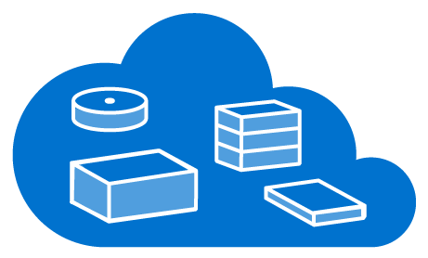
Change is being driven by…
The increasing need for speed in IT delivery.
Widespread adoption of virtualization
Cloud computing business models
Scale-out application architecture
Agile and LEAN practices

Slide 10
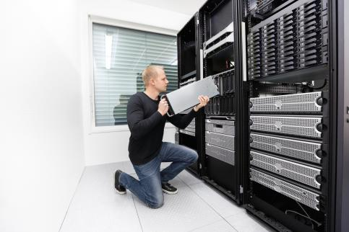
The traditional way of building servers
Hand crafted,
physical systems
requiring multiple
skills to provision.
Still a dominant form of infrastructure today.

Slide 11

The traditional way
The server build process:
Purchase request
Purchase order
Receive components
Build server
Test build/ update firmware
Install OS/Hypervisor
Test server
Rack server
Network provisioning
Storage provisioning
Firewall provisioning
Application server installation
Backup/ Monitoring provisioning
Disaster recovery provisioning
Security testing
Data migration
Application service testing
1 to 6 months later you have a server!

Slide 12

The new way
The cloud server build process:
Review current computing budget quotas
Select pre-validated infrastructure stack
Deploy stack into virtual data center
Automatically load application services and data
5 minutes later you have a server!

Slide 13
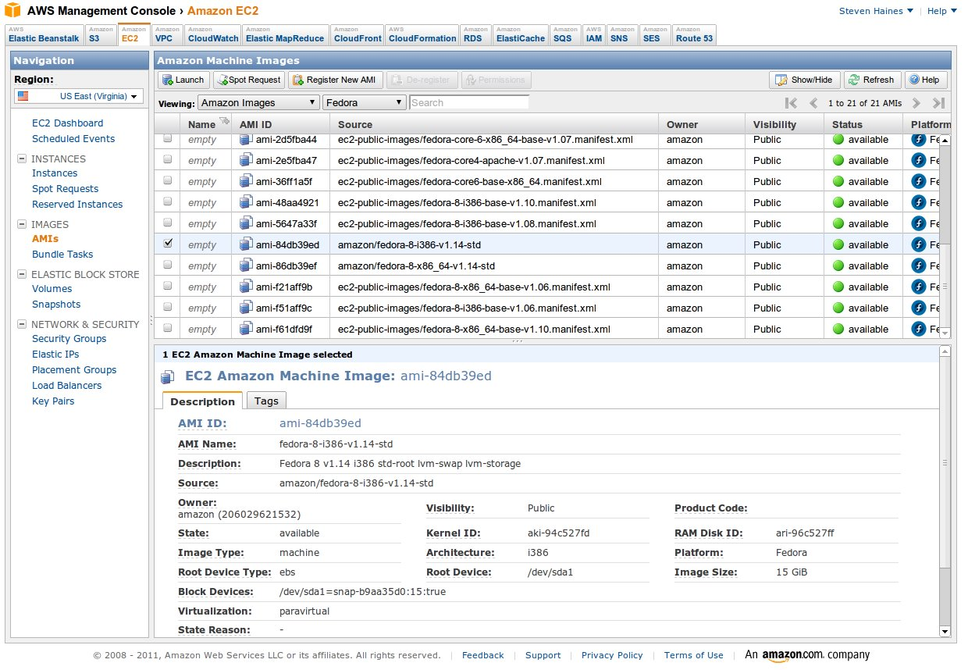
Cloud Infrastructure
Scripted,
automated
infrastructure
available on
demand from a
global cloud
computing service.
The fastest growing form of infrastructure today.
Gartner: 60% of Enterprise workloads will run in the cloud by 2018.

Slide 14

Topics this semester
Source control management
Package management
Automation
Shell scripting
Virtualization
Cloud computing
Configuration Management
Containers
DevOps
Data centers

Slide 15
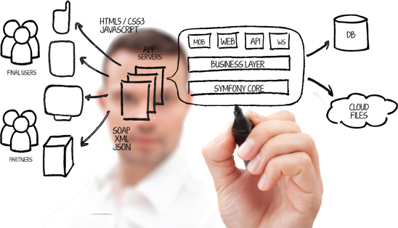
Course Syllabus

Slide 16
Syllabus Notes
This is a survey course and it will not turn you into a DevOps or cloud expert in 4 months.
Nobody is a true expert in all of these topics, including me. Share your knowledge and experience with the class.
Assignments will start out fairly prescriptive at first, but become less so over time.
I want this course to challenge you. ☺

Slide 17
Assignment Grading
Assignment grading is performed in a mostly automated fashion using a test suite.
Assignments must pass a series of tests to receive full points.
#1 cause of losing points: missing files and incorrect file naming.
Case in file names matters!
Double-check your work.
Assignments must meet the requirements AND follow good engineering practices: clarity and maintainability.

Slide 18
How To Earn An A
Attend each weekly lecture.
Complete weekly readings.
Complete all homework assignments.
Score above average in both exams.

Slide 19
Attendance

Slide 20
Source Control Management
Definition: “A component of software configuration management, version control, also known as revision control or source control, is the management of changes to documents, computer programs, large web sites, and other collections of information.” – Wikipedia
In our world, source control is simply a database that stores all the changes made to a set of text files.

Slide 21
Source Control Management
We use source control systems to:
Store and track changes in software source code and application configurations (or most any sort of text-based artifact)
Maintain different releases of software code
Effectively collaborate as a team on a single set of artifacts
First systems was SCCS, written in 1972 by Rochkind at Bell Labs
Then came RCS, CVS, and Subversion
Dozens of commercial solutions available: Perforce, ClearCase, Microsoft TFS
Bottom line: Source control is about maintaining file history.

Slide 22
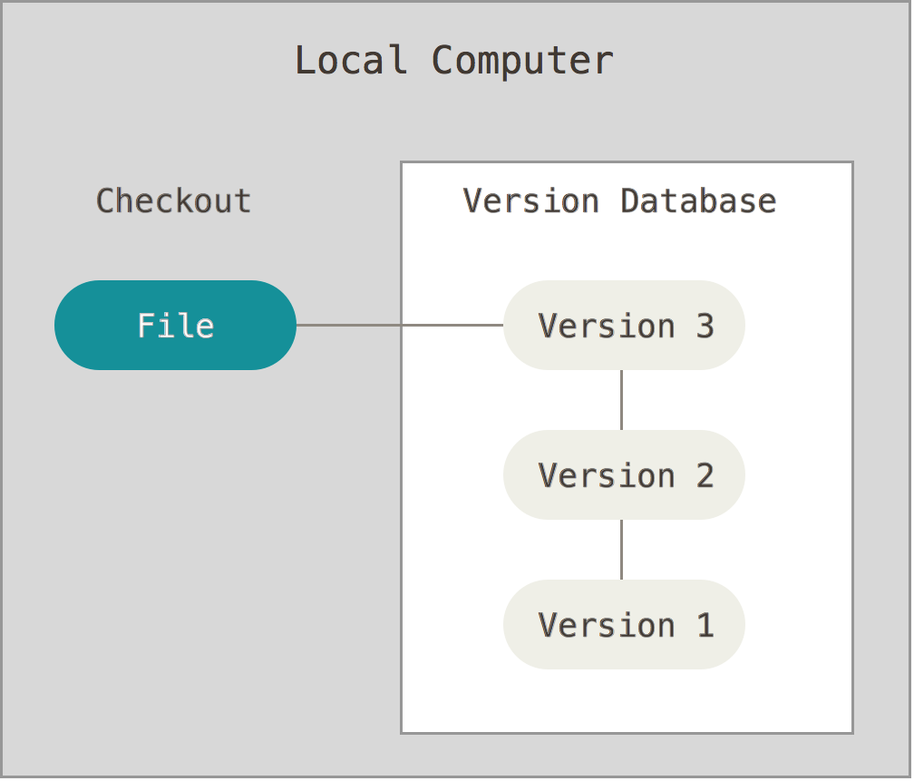
Types of source control
Local
Simple file
versioning
RCS
Image from https://git-scm.com/book/en/v2/Getting-Started-About-Version-Control

Slide 23
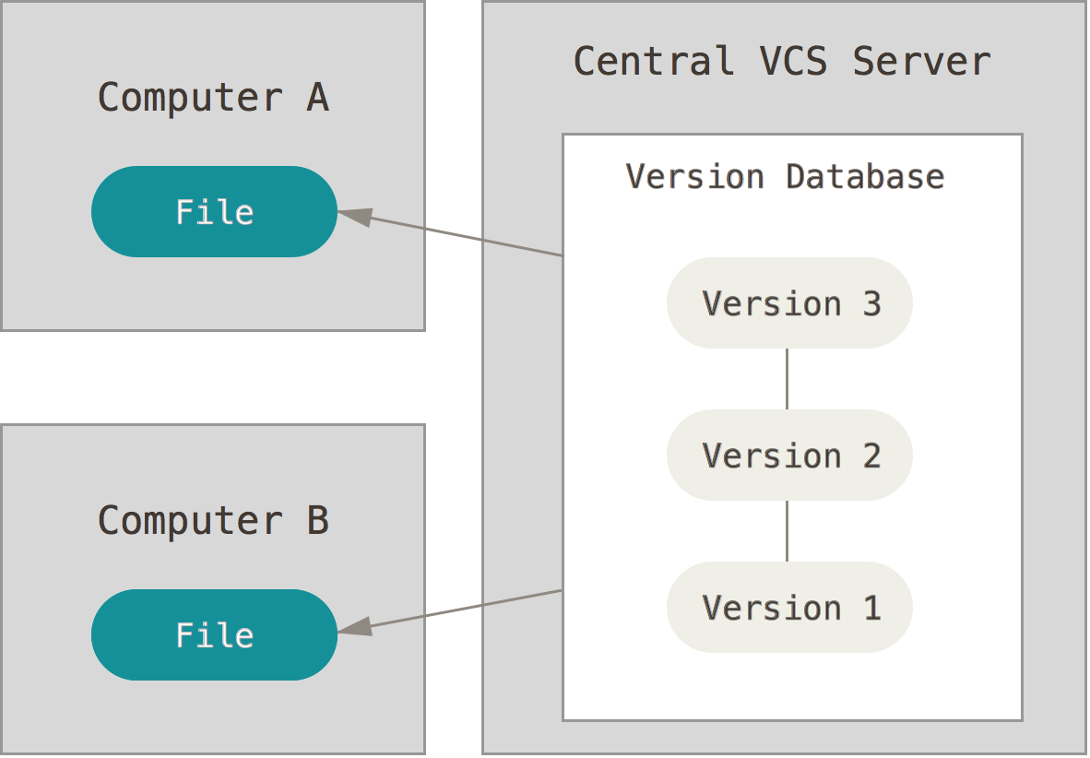
Types of source control
Centralized
Team approach
Everyone works
on same files
Server = single
point of failure
Hard to branch
Example: Subversion
Image from https://git-scm.com/book/en/v2/Getting-Started-About-Version-Control

Slide 24
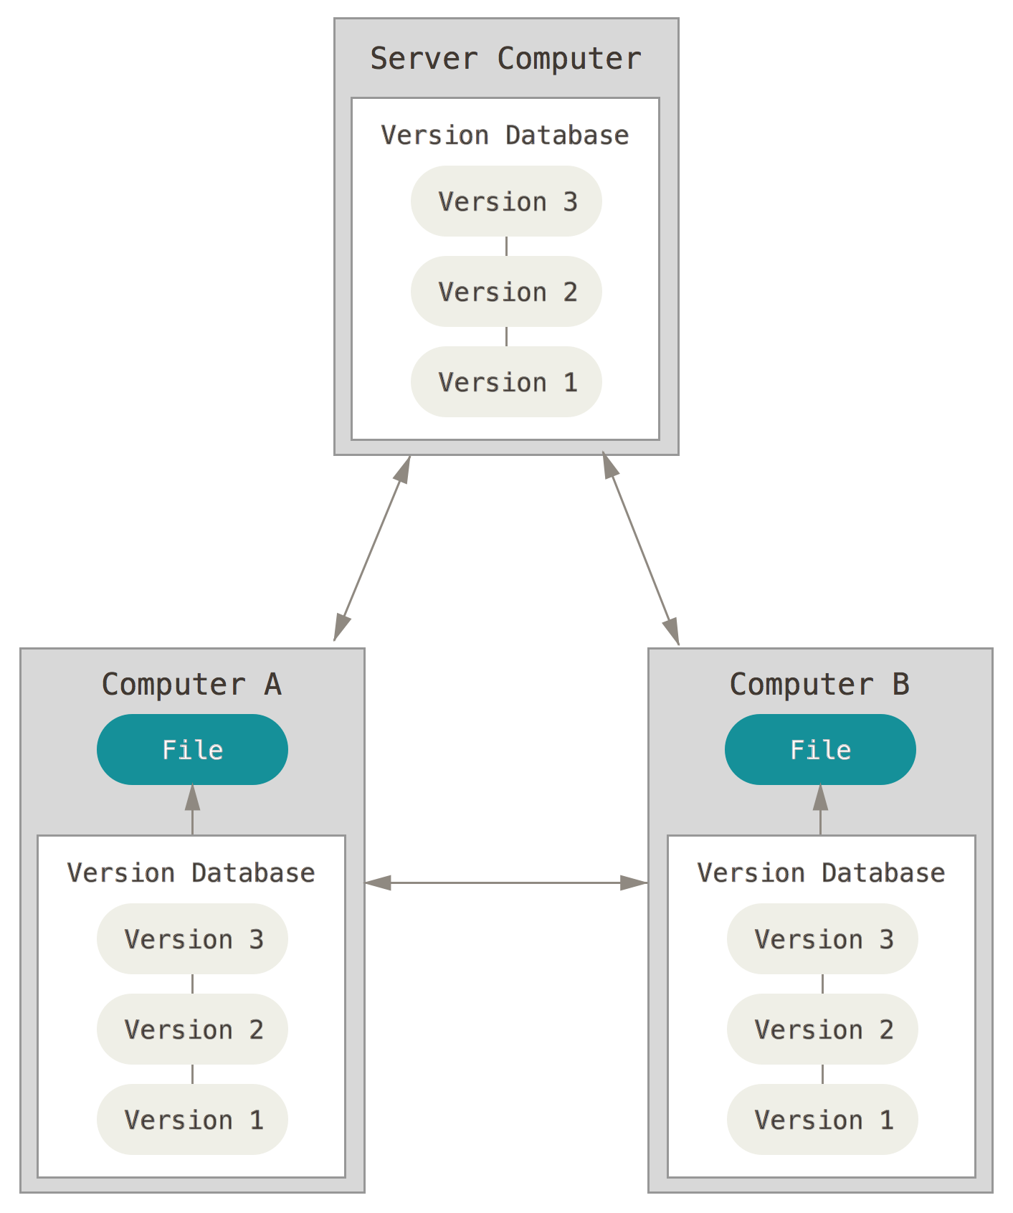
Types of source control
Distributed
Team approach
Everyone works
on their own files
Easy to branch
Need to handle merge
Conflicts
Example: Git
Image from https://git-scm.com/book/en/v2/Getting-Started-About-Version-Control

Slide 25
Git
Most popular distributed source control management system
Open Source
Initially designed by Linus Torvalds (Linux) in 2005
Goals:
Super fast patching
Supports one developer or thousands of developers
Designed from a file-system perspective, not a source control management perspective

Slide 26
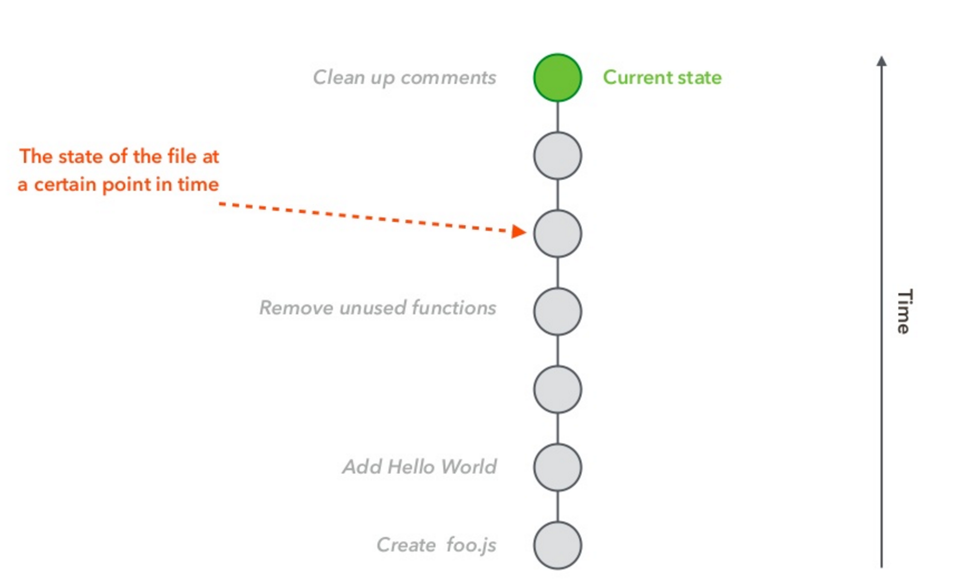
File
Source: An Introduction to Git by Hiroyuki Vincent Yamazaki

Slide 27
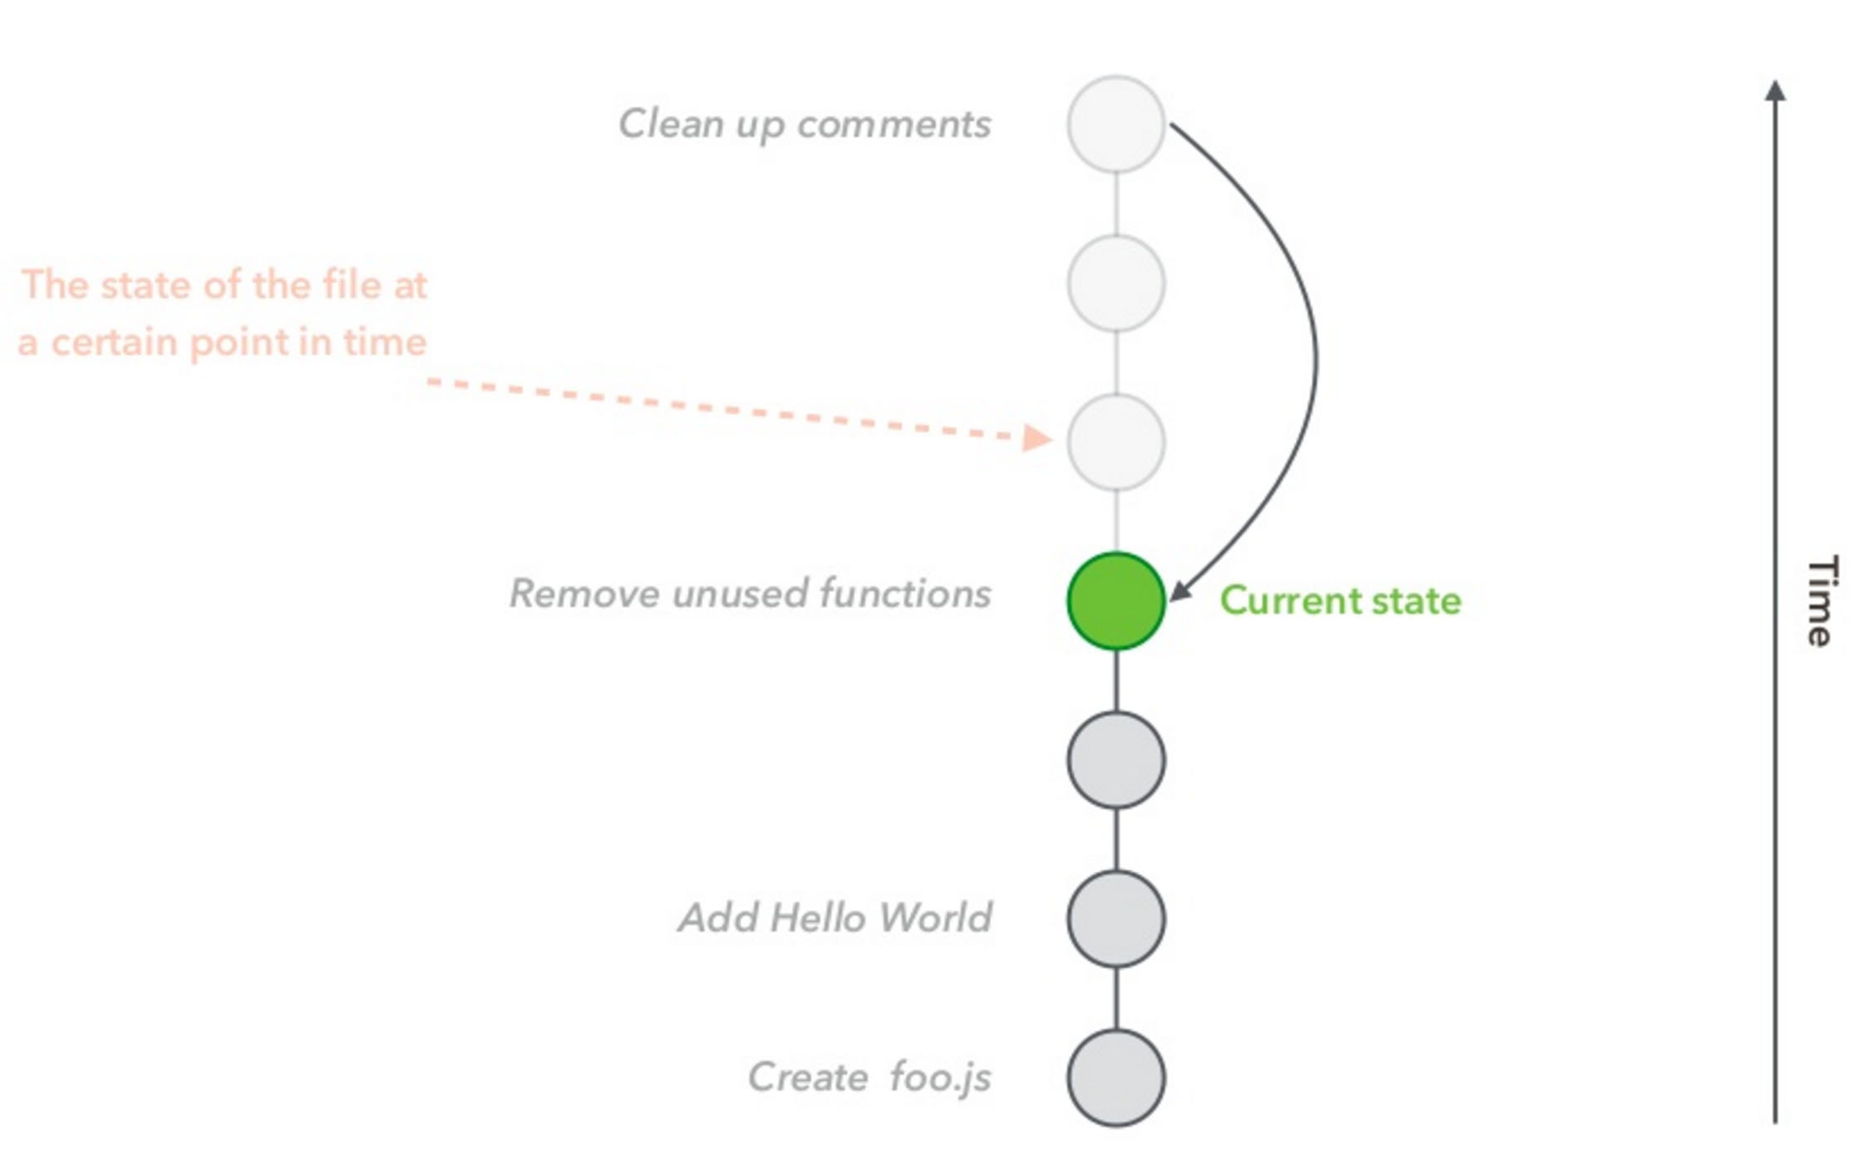
File
Source: An Introduction to Git by Hiroyuki Vincent Yamazaki

Slide 28
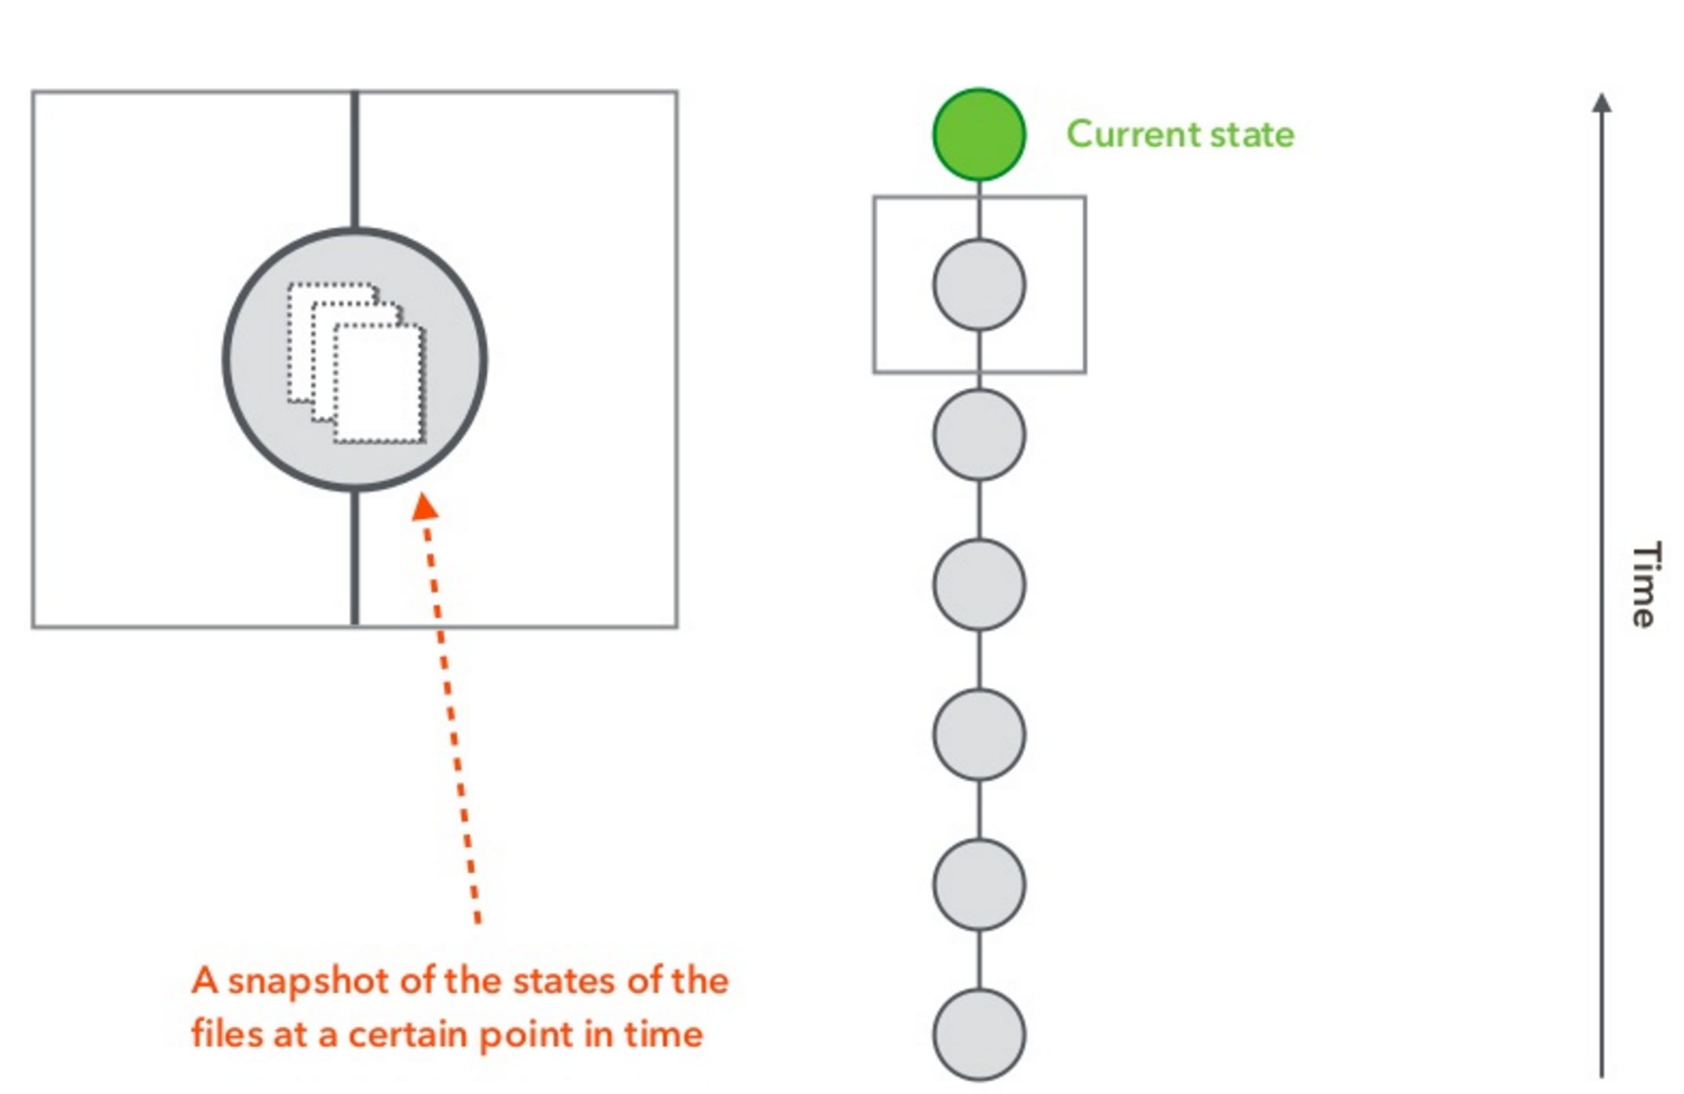
File(s)
Source: An Introduction to Git by Hiroyuki Vincent Yamazaki

Slide 29
Creating a Project
Start a new project:
> git init
Download an existing project:
> git clone <url>
Source: An Introduction to Git by Hiroyuki Vincent Yamazaki

Slide 30
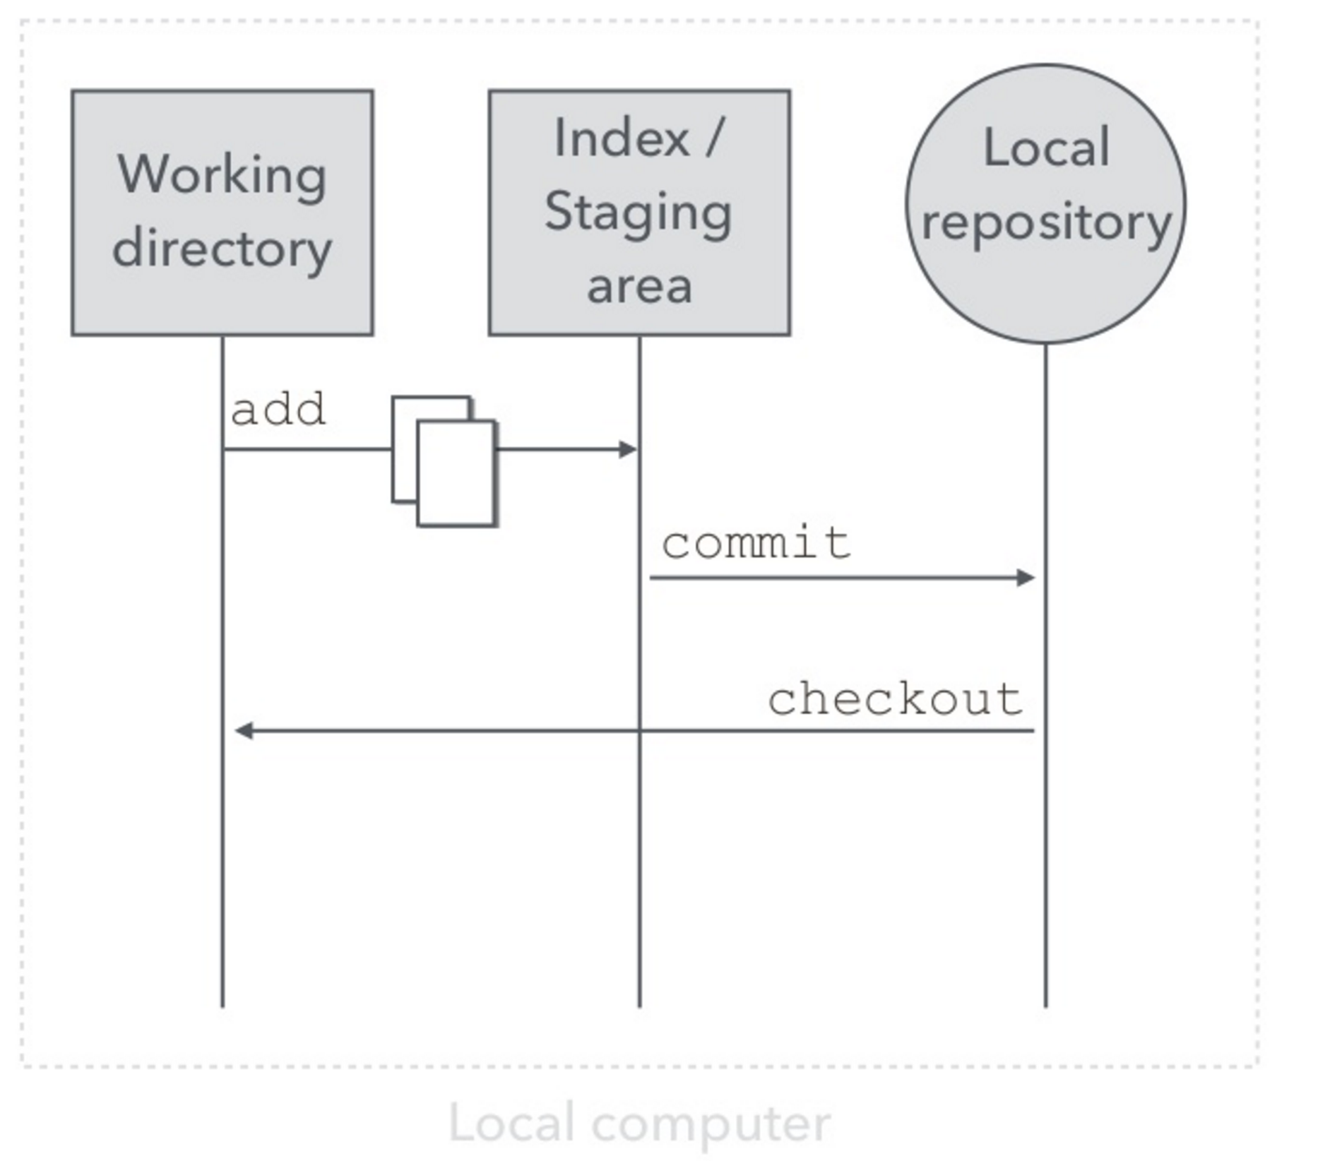
How Git works
Source: An Introduction to Git by Hiroyuki Vincent Yamazaki

Slide 31
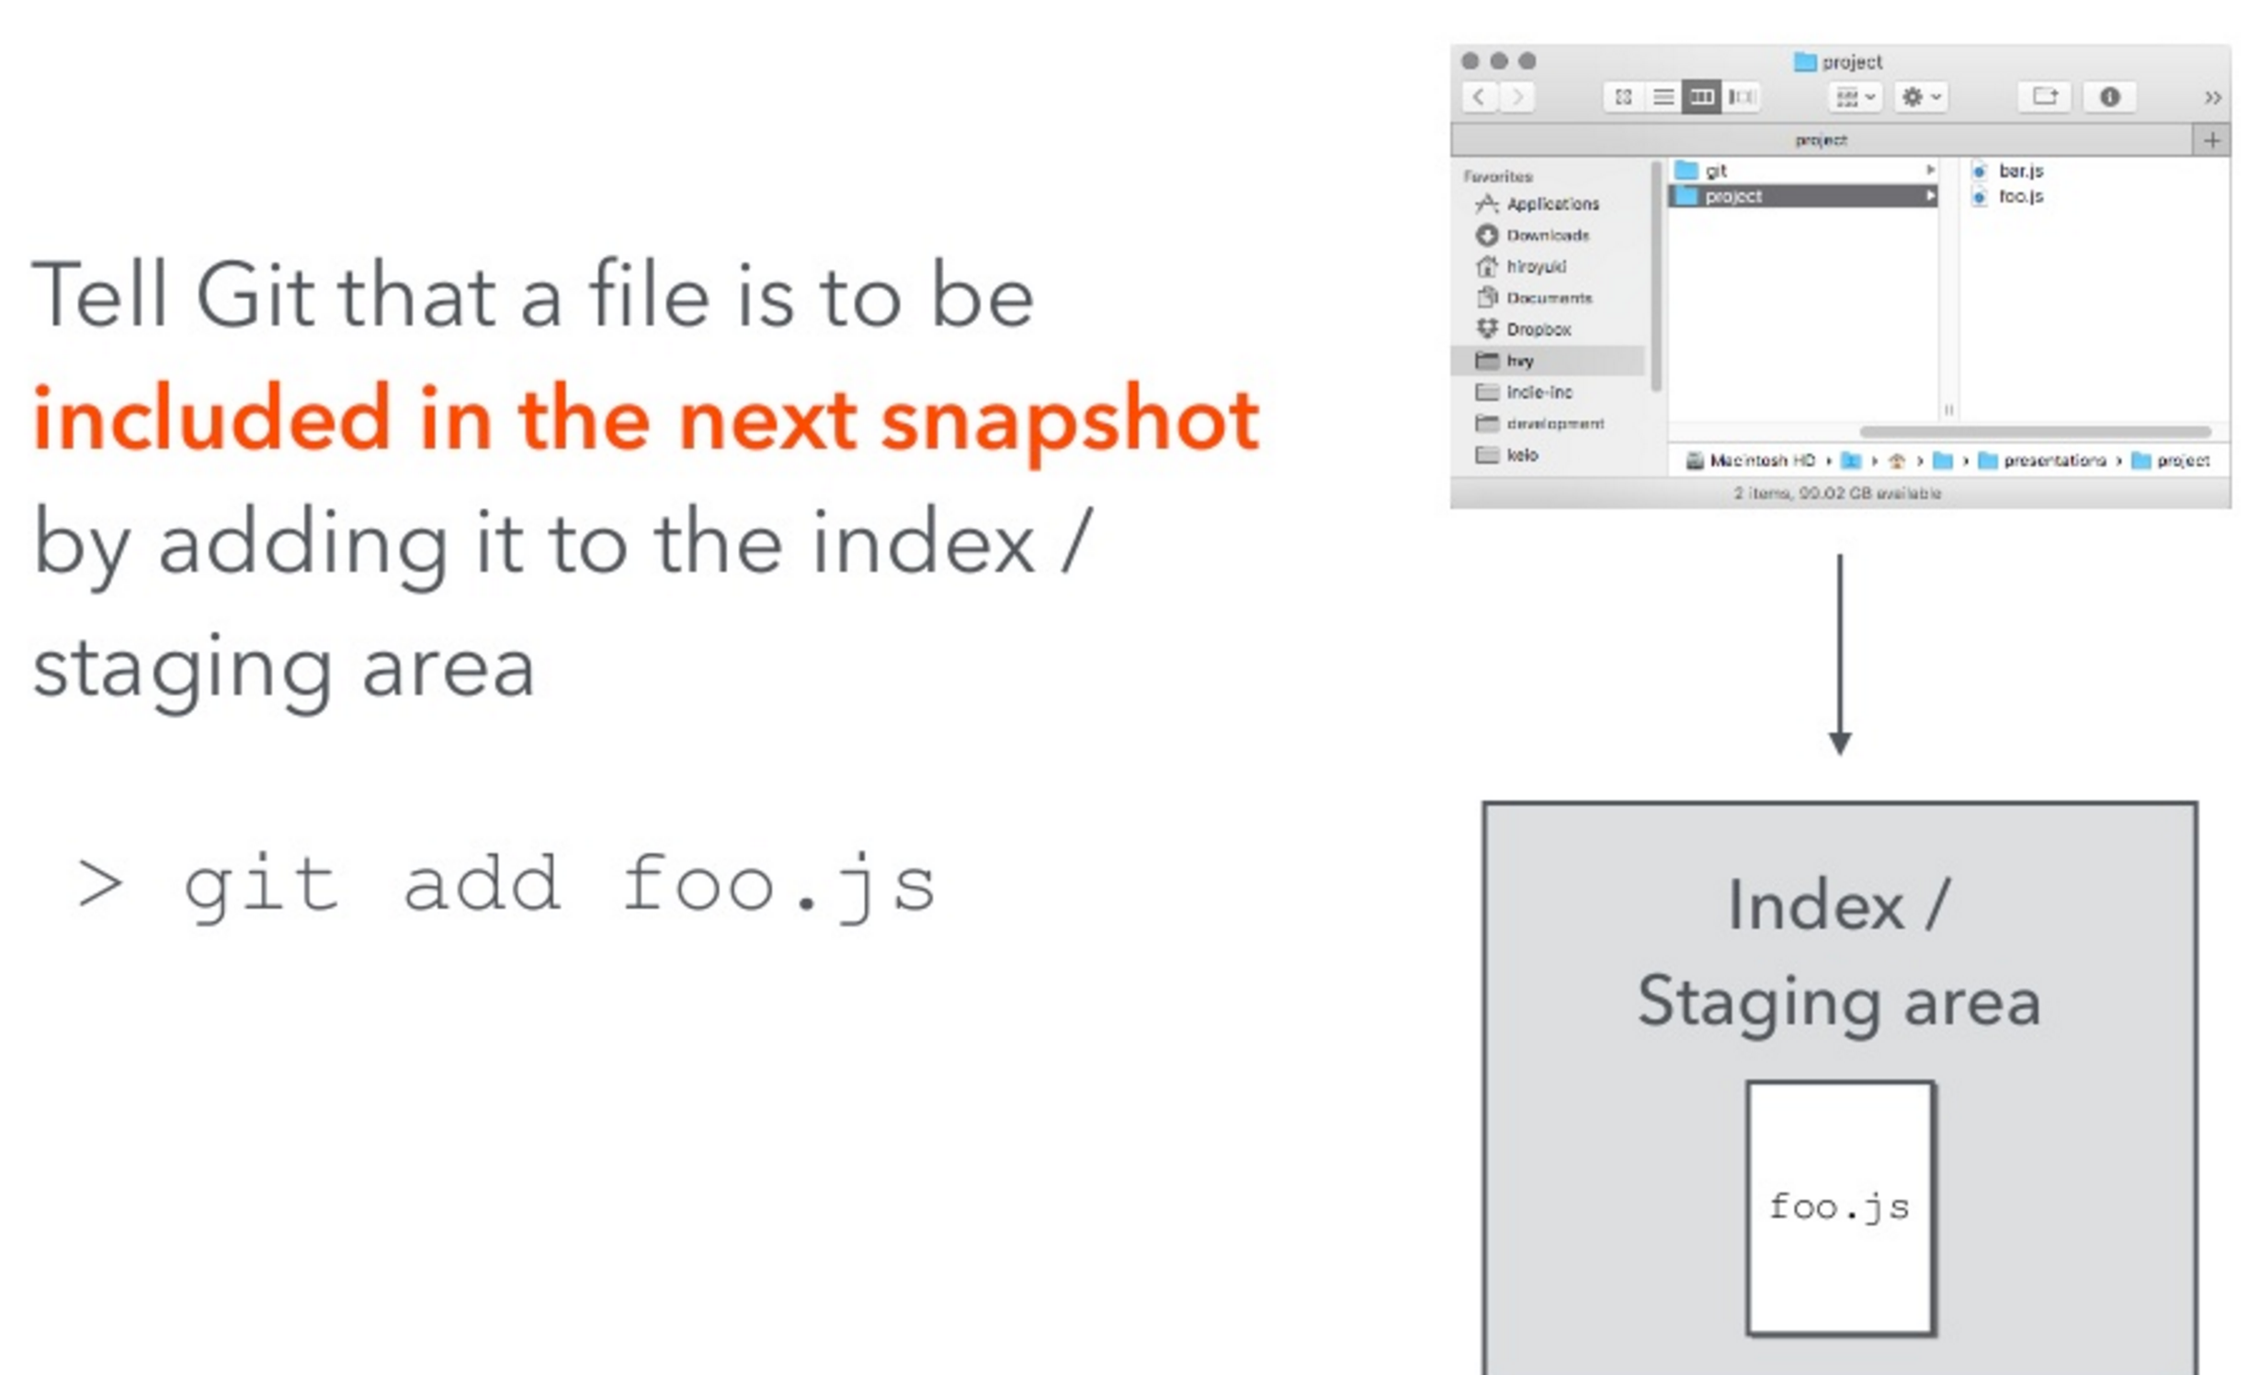
Add command
Source: An Introduction to Git by Hiroyuki Vincent Yamazaki

Slide 32
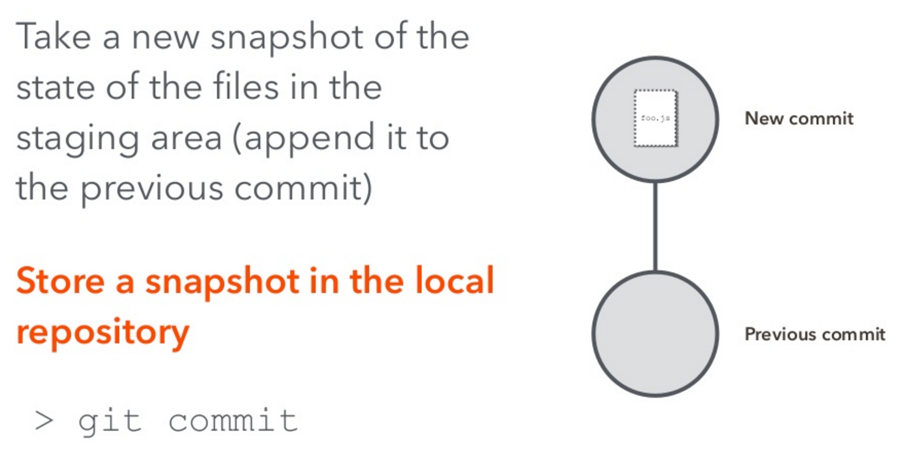
Commit command
Source: An Introduction to Git by Hiroyuki Vincent Yamazaki

Slide 33
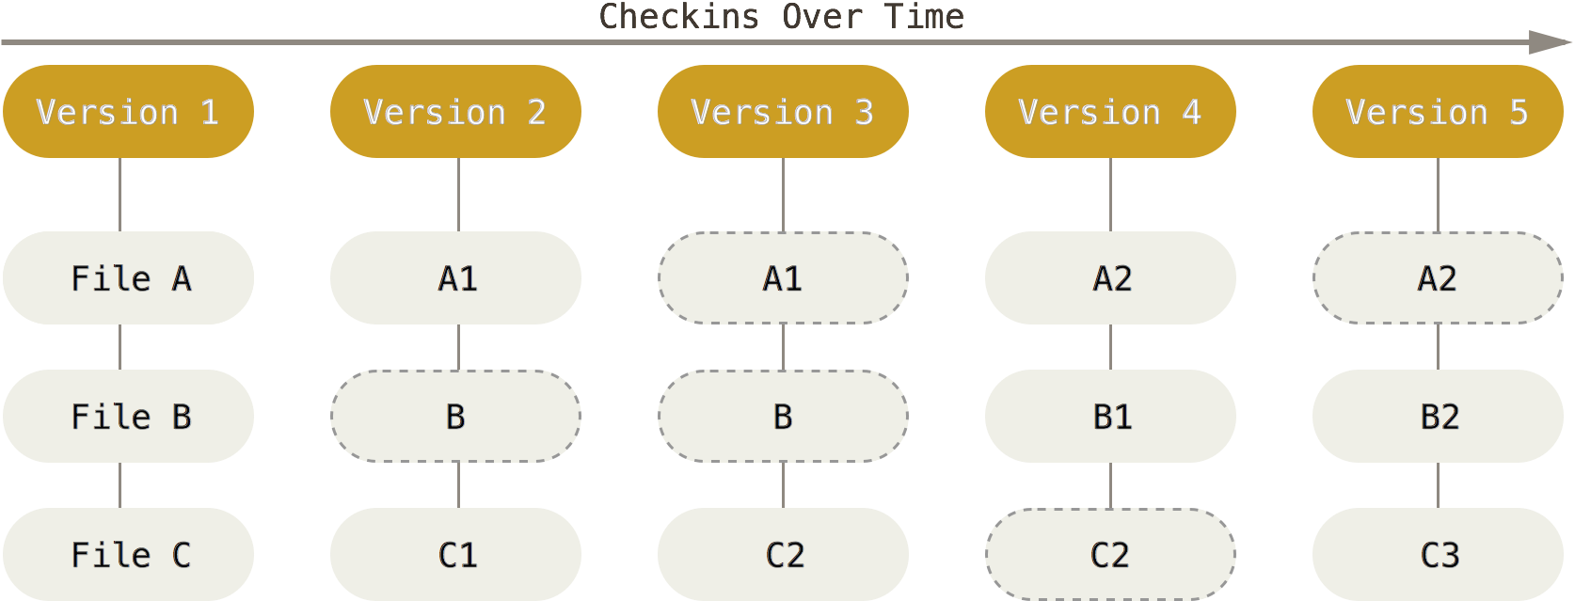
How Git Works
Git only creates new files when a file is modified.
Git stores references to files.
Image from https://git-scm.com/book/en/v2/Getting-Started-Git-Basics

Slide 34
Git Commits
Commits contain:
SHA-1 checksum (Commit Hash)
Author
Date
Message
Reference to parent commit(s)
Tree
Contains references to all the files in the snapshot
Source: An Introduction to Git by Hiroyuki Vincent Yamazaki

Slide 35
Git Tree
Git uses a Directed Acyclic Graph (DAG)
Commits flow from left-to-right like a timeline.

Slide 36
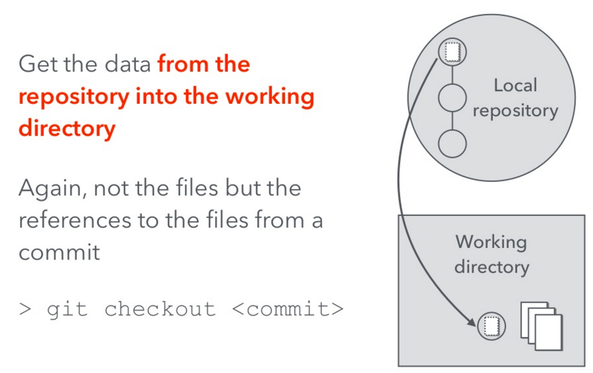
Git Checkout
Source: An Introduction to Git by Hiroyuki Vincent Yamazaki

Slide 37
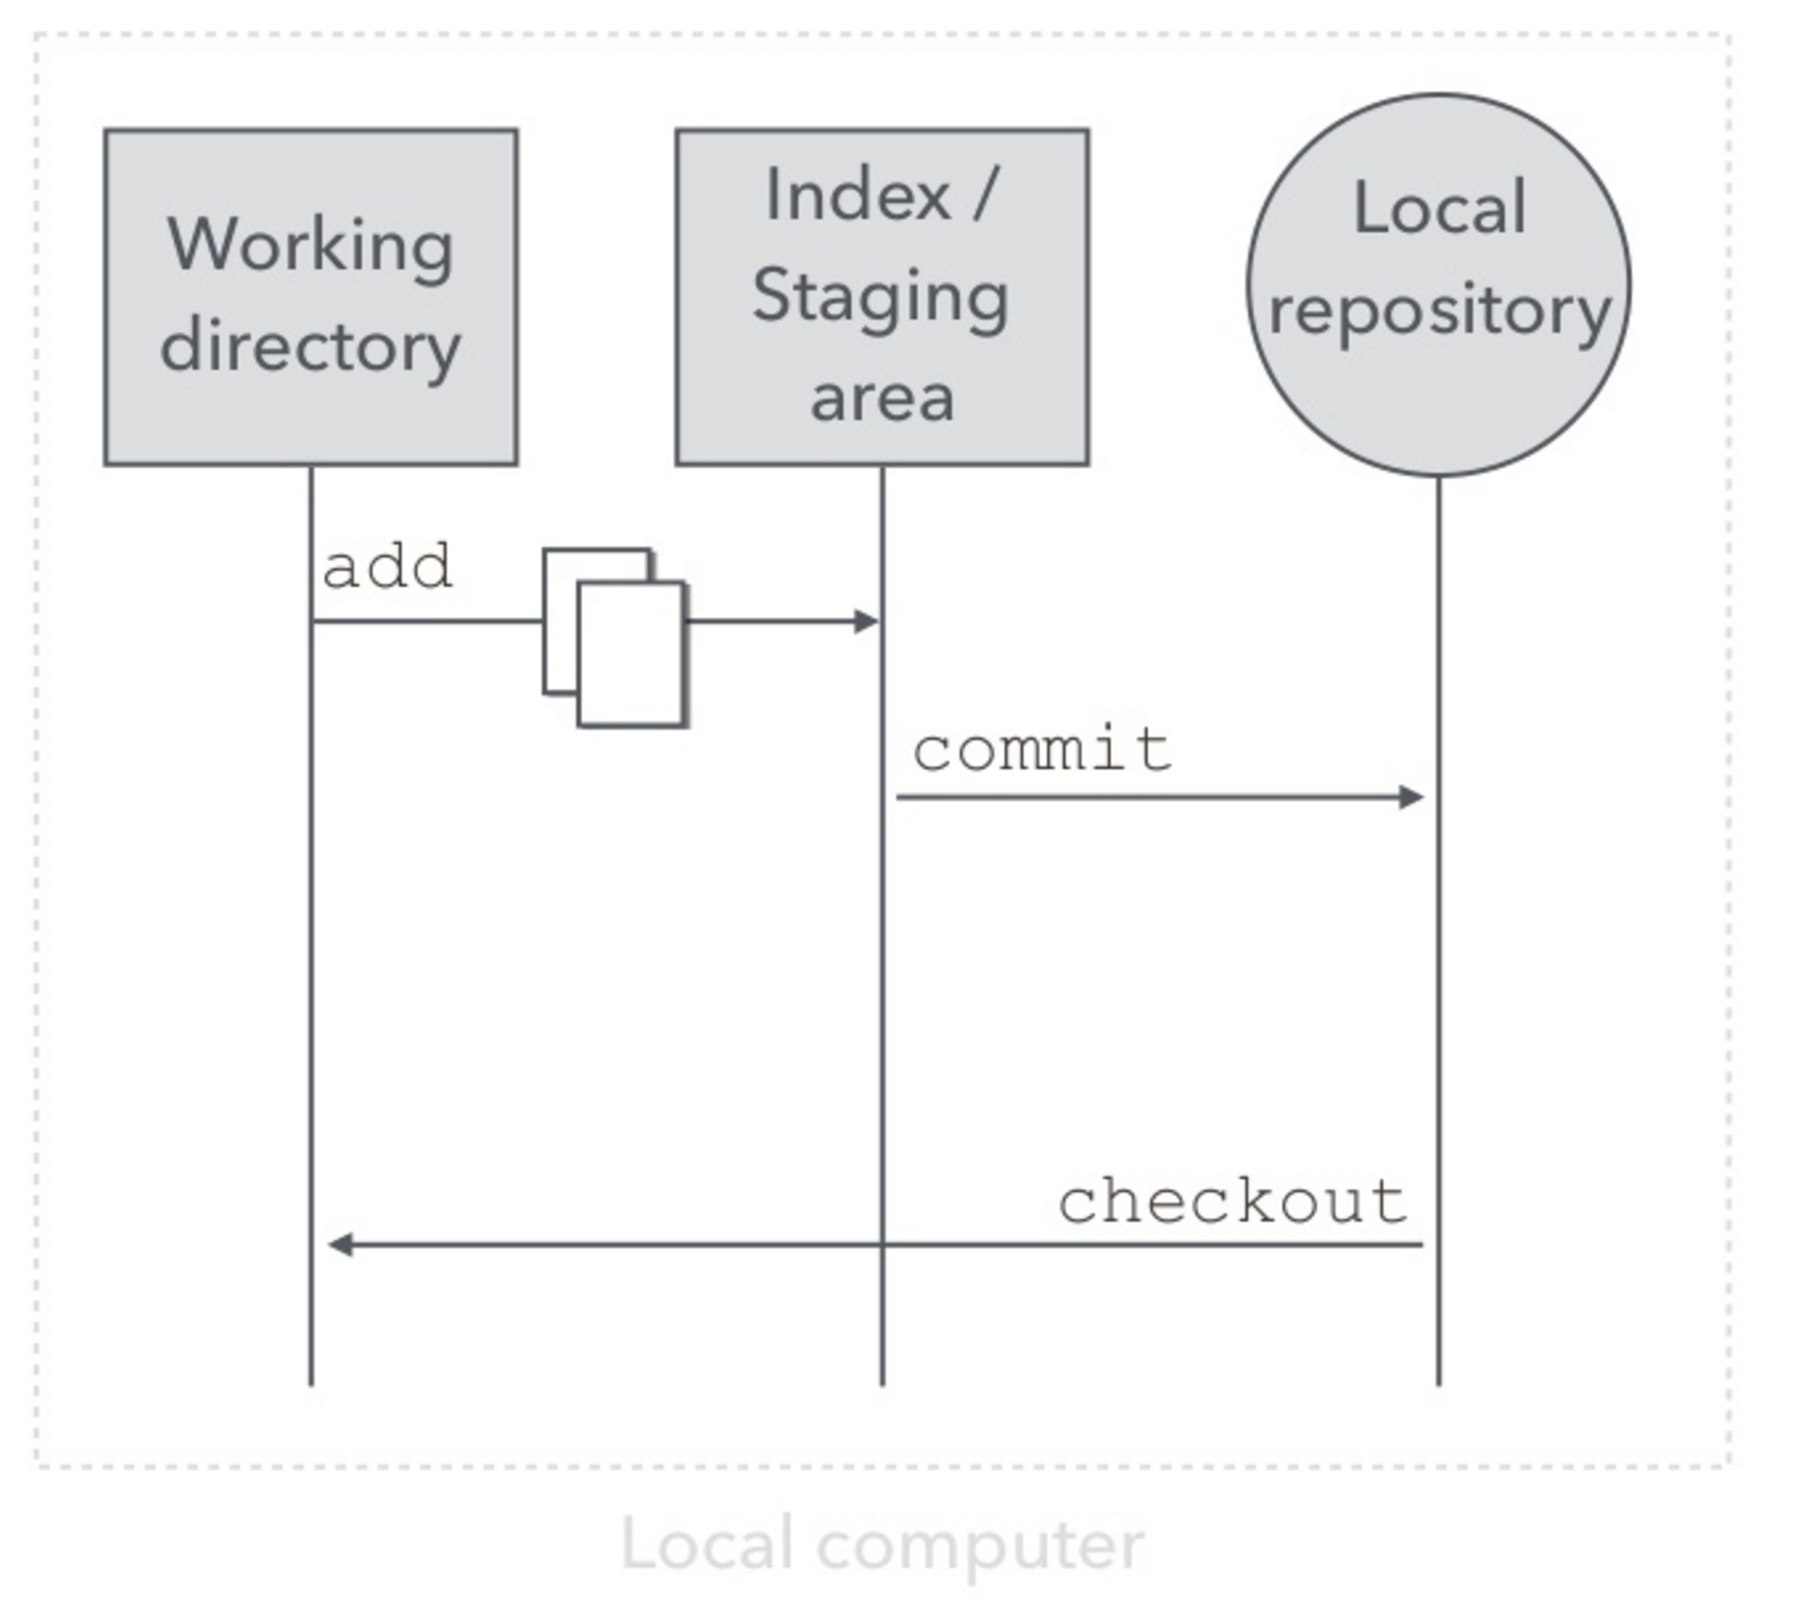
Git Collaboration
Source: An Introduction to Git by Hiroyuki Vincent Yamazaki

Slide 38
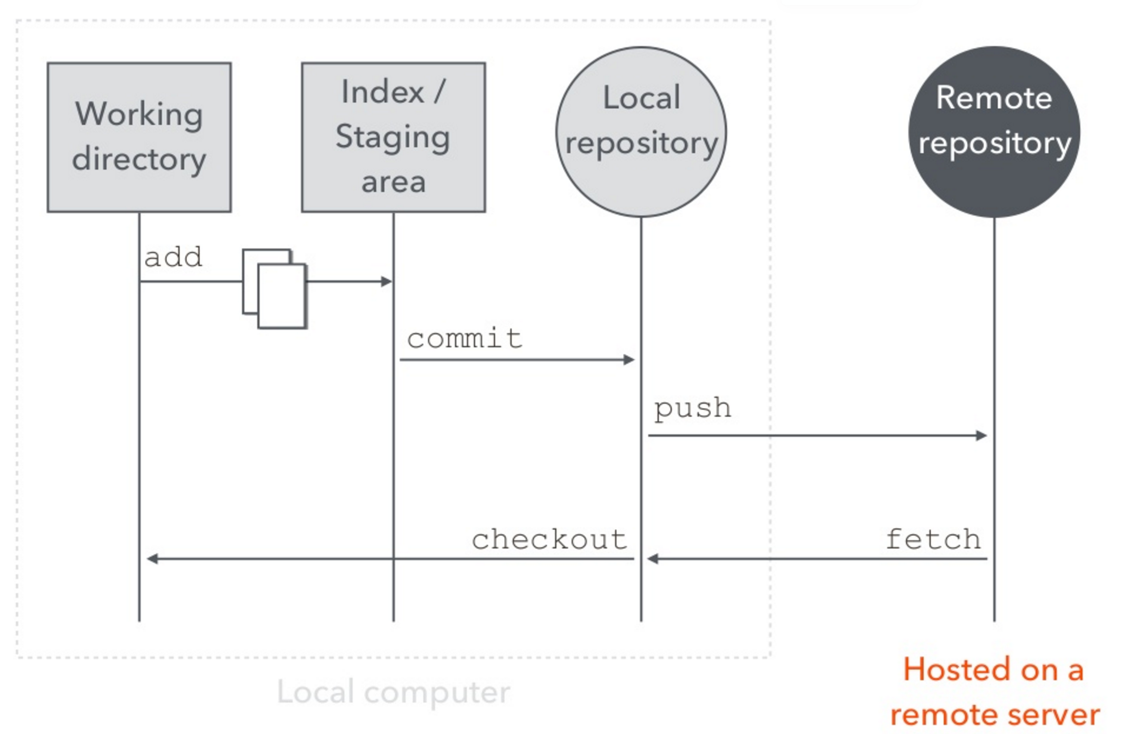
Git Collaboration
Source: An Introduction to Git by Hiroyuki Vincent Yamazaki

Slide 39
Remote Repository
The remote repository is a copy of the local repository hosted on a network.
Other people can clone the remote repository to download their own copy.
GitHub provides a place to host a remote repository.
Source: An Introduction to Git by Hiroyuki Vincent Yamazaki

Slide 40
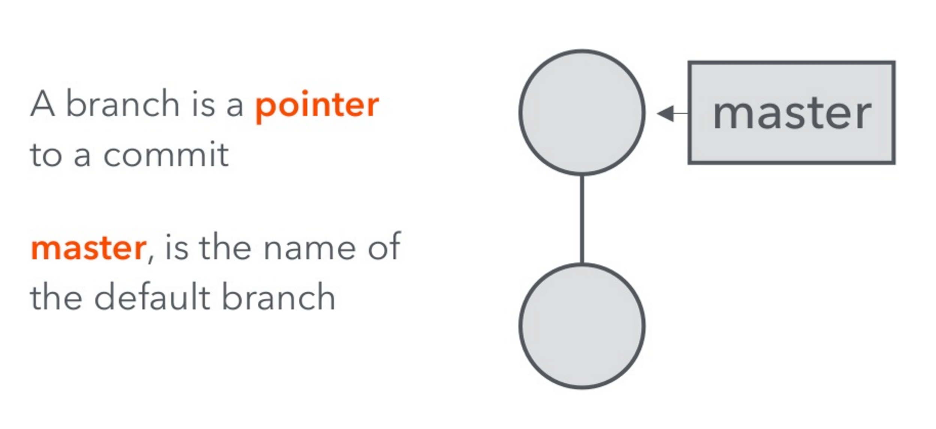
Git Branch
Source: An Introduction to Git by Hiroyuki Vincent Yamazaki

Slide 41
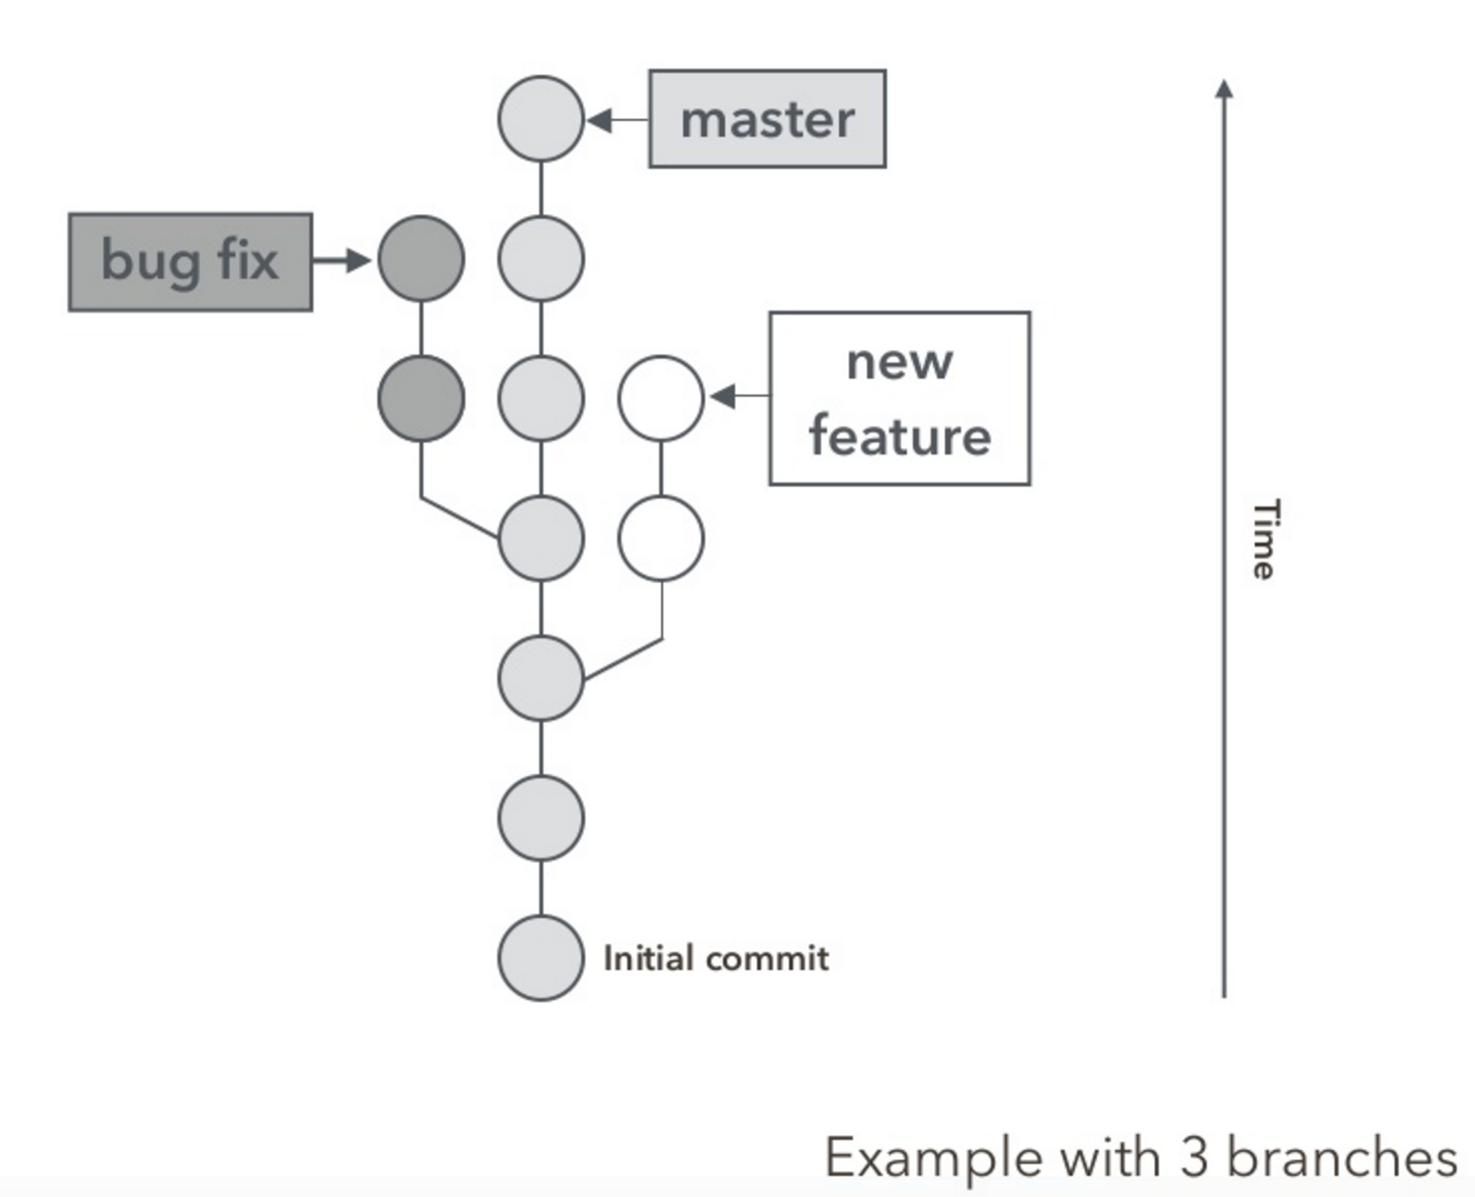
Git Branch
Source: An Introduction to Git by Hiroyuki Vincent Yamazaki

Slide 42
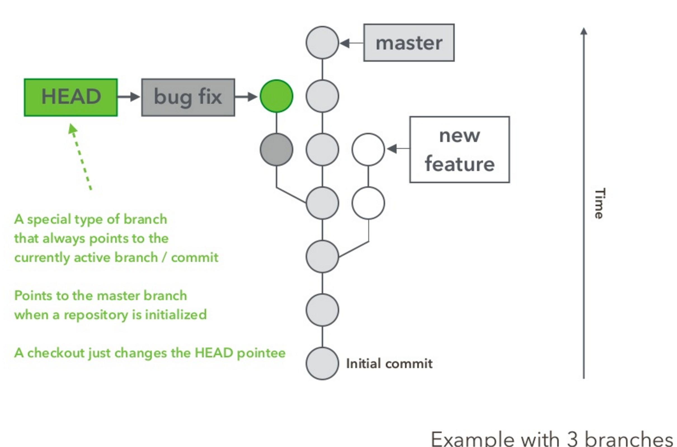
Git Branch
Source: An Introduction to Git by Hiroyuki Vincent Yamazaki

Slide 43
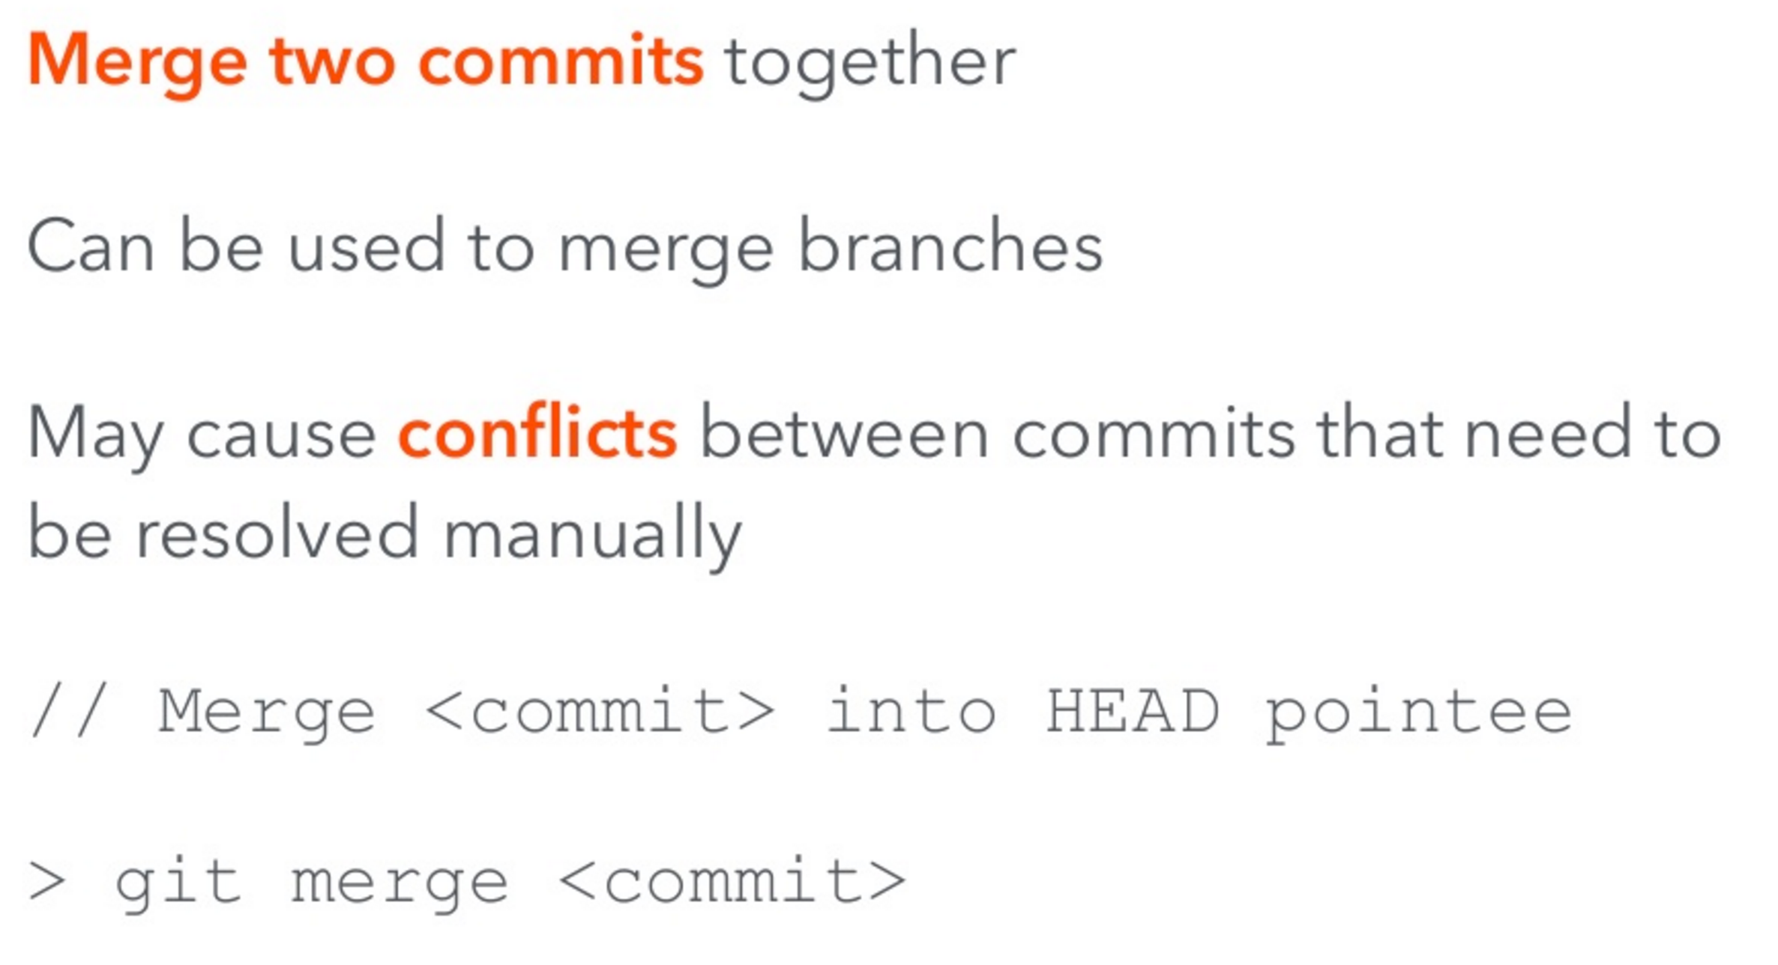
Git Merge
Source: An Introduction to Git by Hiroyuki Vincent Yamazaki

Slide 44
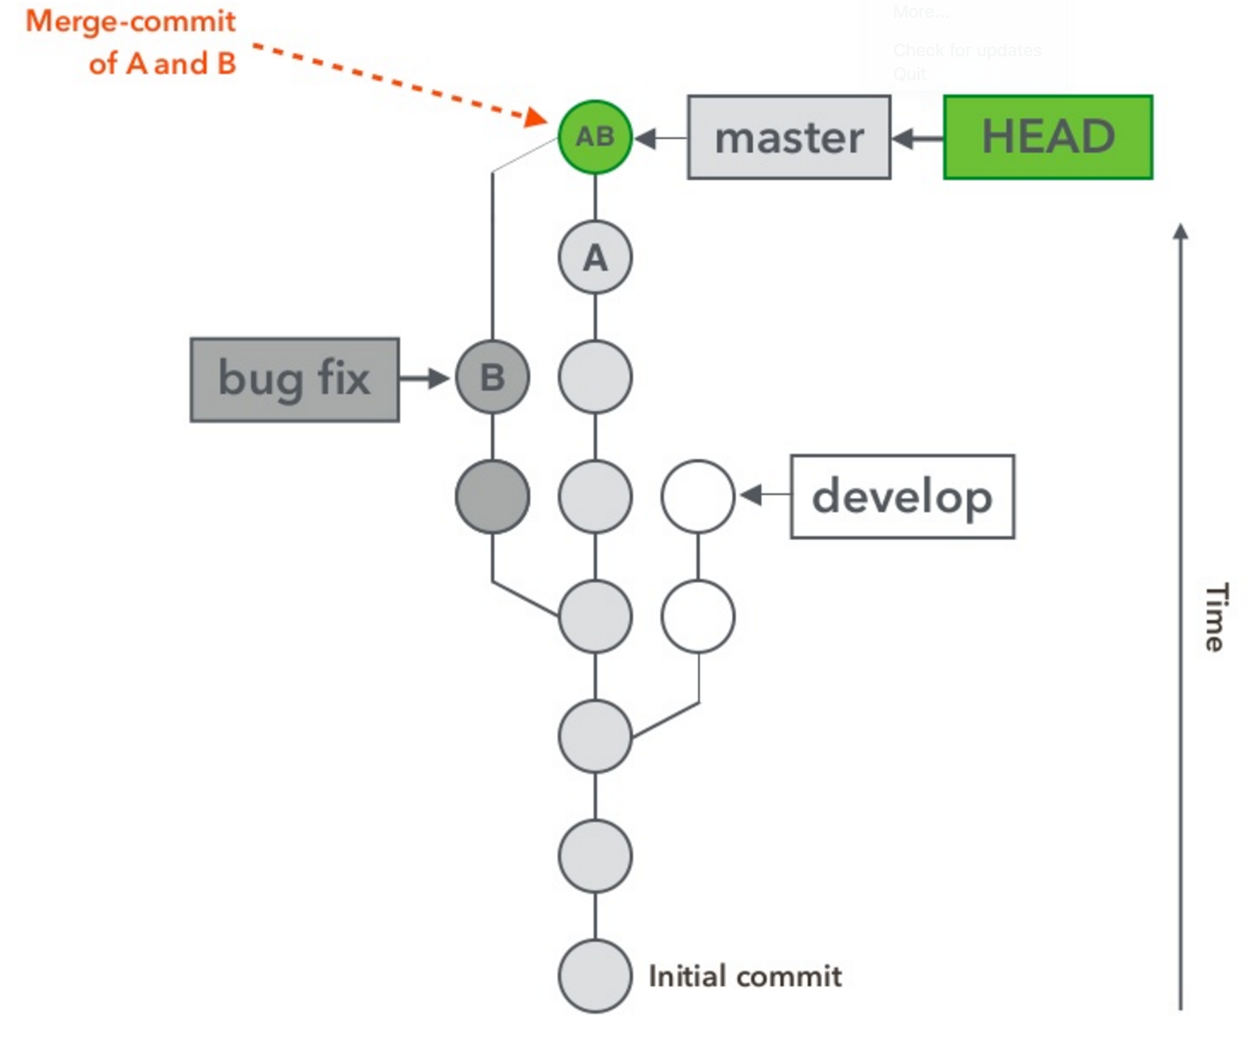
Git Merge
Source: An Introduction to Git by Hiroyuki Vincent Yamazaki

Slide 45
Git Hands-on
The best way to learn Git is by using the git command using a command line interface (terminal shell)
You can also use graphical Git clients such as Source Tree
These are very helpful when working with large teams
Refer to Git Hands-On Guide
Book: https://git-scm.com/book/en/v2

Slide 46
Homework
Assignment 1: Set up accounts
Read Practice of Cloud Systems Administration Chapter 12, sections 12.1-12.6
Read Git Hands On Guide
Start reading Linux Hands On Guide

